Slide 1
National Pediatric Disaster Coalition: exercise
WRAPEM Crisis Standards of care project

Slide 2
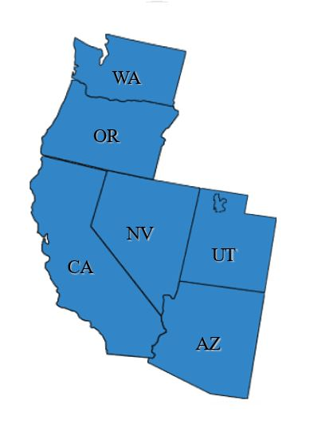
Institutions / Facilities:
Seattle Children’s (UW)
Providence Healthcare (Sacred Heart)
Multicare (Mary Bridge)
OHSU
UC Davis
UCSF
Stanford
Kaiser Permanente
Valley Children’s Hospital (Fresno)
Loma Linda University
CHLA (USC)
Lindquist Institute (Harbor-UCLA)
Cedars Sinai
Rady Children’s
University Medical Center (UNLV)
Phoenix Children’s (ASU)
Primary Children’s (Salt Lake)
Agencies / Coalitions / Societies:
State – Departments of Health
State EMS and EM
Hospital Preparedness Program (HPP)
Western Peds Preparedness Partnership
National Pediatric Disaster Coalition
Poison control Centers
Burn Center Consortium
Ebola Biocontainment Centers (NETEC)
Regional Special Pathogens Programs (RESPTC)
AMR Ambulance
Reach / Calstar Air medical Ambulance
State Hospital Associations
6 States ~14 Million Children

Slide 3
Crisis Standards 2010-2020
National Academy of Medicine Consensus statements
SOFA and Pelod Scores
Existing plans
Minnesota
Seattle

Slide 4
References and Resources
WRAPE-EM.org
https://www.nationalacademies.org/our-work/forum-on-medical-and-public-health-preparedness-for-disasters-and-emergencies
https://www.networkforphl.org/attorneys-and-staff/james-g-hodge-jr/

Slide 5
SOFA and Pelod-2
Sequential Organ Failure Assessment (SOFA):
https://files.asprtracie.hhs.gov/documents/aspr-tracie-sofa-score-fact-sheet.pdf

Slide 6
Pediatric Organ Logistic Dysfunction (PELOD)-2 score
PELOD-2: An Update of the Pediatric Logistic Organ Dysfunction Score. Critical Care Medicine: July 2013

Slide 7
COVID: Peds Crisis Standards
2020 Concerns, challenges and calls for help:
Similar pediatric concerns:
“Scores not practical”
“Withdrawal” or “restriction” of care not acceptable
Anxiety - public perceptions - emotional impact
Limited alternatives
Long term vs acute nature of event
Response:
Collection of existing standards and legal perspectives
Consolidate best practice / advice into a bullet point template table
Platform for information-sharing
Multi-jurisdictional virtual meetings. “Town Halls”

Slide 8
Developing a pediatric plan
Narrative:
Ethical Rational and accepted standards
“Practical Considerations”
Intent, safeguards, scope, etc.
Triggers
Declarations process
De-escalation process
Legal considerations
Pediatric specific considerations
Integration with adult healthcare and hospital / agency administration

Slide 9
Crisis Standards: lessons Learned
Consider the full spectrum: normal to surge to contingency to crisis
The best “CSC plans” keep the institution out of the crisis state in the first place.
Contingency: doing everything possible to accomplish statement above
Example: Load balance or EMS adjustments across system/ region
There is no circumstance of “no care at all”.
State what you CAN DO, not what you CAN NOT DO
CSC plans exist to protect against inequities, not to justify them.
Scores (ie – PELOD-2) are great optional tools. But, are not “the plan”.
Does your command center have a pediatric advisory role?
Adult / peds integration

Slide 11
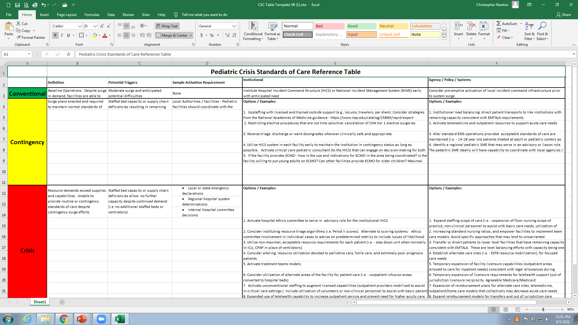
Specific Example: Pediatric CSC Template

Slide 12
Contingency
Example: Pediatric CSC Template
Institutional options
System options
1. Upstaffing with licensed and trained outside support (e.g., locums, travelers, per diem). It's important to compare current staffing contingencies at hospitals within the area to make sure that there's as consistent level of care provided as possible. | 1. Institutional load balancing: direct patient transports to like institutions with remaining capacity consistent with EMTALA requirements
2. Restricting elective procedures that are not time sensitive: delay of CHA tier 1 elective surgeries | 2. Activate outpatient resources that may support acute care needs (telemedicine, primary care system, home nursing, etc)
3. Reverse triage: discharge or ward downgrades wherever clinically safe and appropriate. | 3. Alter standard EMS operations provided acceptable standards of care are maintained (i.e. - 14-18 year old patients treated at adult or pediatric centers as capacity allows, limits on transport of non-urgent patients consistent with EMTALA requirements).

Slide 13
Specific Examples
Pediatric – Adult system Load Balancing
Adjustment of age cutoffs for EMS flow
12-18 at adult facilities
18-21 at pediatric facilities
Resource sharing
PICU physician and nursing cross training
Ventilators, dialysis, ECMO circuits, etc.

Slide 14
Specific Examples
Pediatric specific needs and options:
Defining “Critical Pediatric”: What MUST be at the tertiary care center.
Special health care needs
Neuro and cardiac conditions
Pediatric Oncology
Neonatal
Leveraging unique pediatric resources
Pediatrician medical office infrastructure
Urgent care facilities
Telehealth – home care
School nursing capabilities

Slide 15
Specific Examples
Identifying “elective” pediatric.
Expectation management for families
Altering standards of immediate care expectation for children
Leveraging Primary Care
Pre-determined acceptable delay standards
Risk assessments for elective procedures
Social care considerations
Parental work, transportation and access, child care, siblings, Shelter and food insecurities.

Slide 16
Scoring Systems
Identify the best possible scale
PELOD-2
Modify based on local resources (ie – dialysis / ECMO capabilities)
Involve pediatric hospital ethics as HICS advisors
Implementation process
Triage waiting list (rather than denial)
Refresh resource as soon as able
Adjunct support for those on the waiting lists
Extended dialysis schedules – lab based dialysis
US vs CT vs MRI
Non-invasive ventilation maneuvers

Slide 17
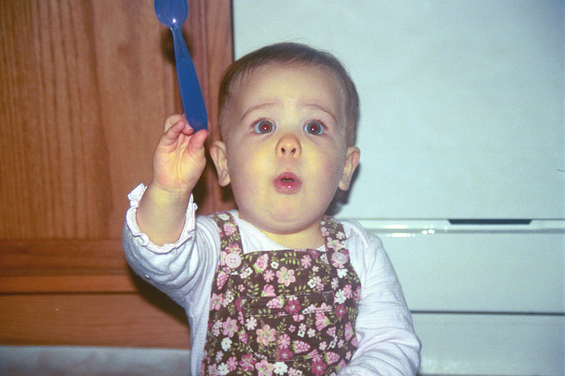
Questions

