Slide 1
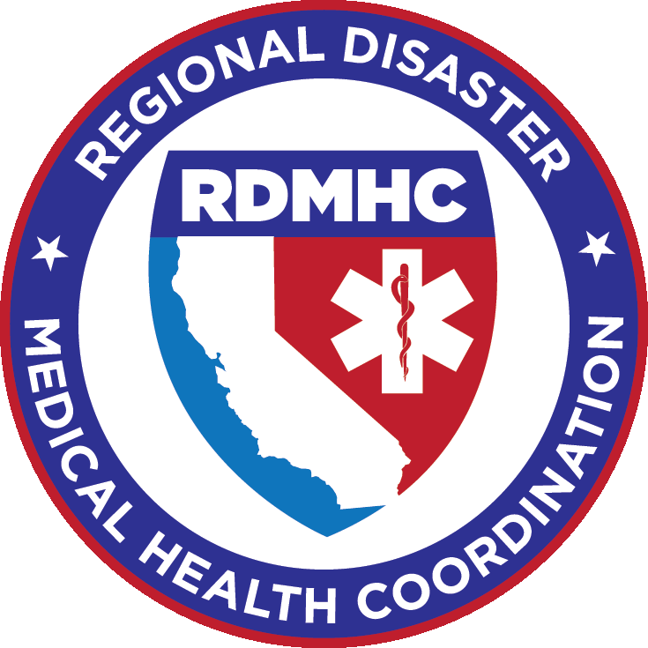
California Local & Regional Medical/Health Coordination
Jeremy Fahey, EMT-Paramedic
CalOES Region I Regional Disaster Medical Health Specialist (RDMHS)
Counties of Orange, Los Angeles, Ventura, Santa Barbara, San Luis Obispo
LA County EMS Agency: Senior Disaster Services Analyst
jfahey@dhs.lacounty.gov

Slide 2
Local Coordination
Medical
Health
Operational
Area
Coordinator
(MHOAC)
Overview
Pronounced Mohawk
Non-funded position
Health and Safety Code §1797.153
ESF – 8 Disaster Coordination
Standardized Reporting
Relationships
Medical Health
Public Health
Mental Health
Environmental Health

Slide 3
What are the 17 MHOAC Functions?
Patient Movement
Immediate Medical Needs
Disaster Medical and Health Resources
Field Treatment Sites
Medical/Health Public Information
MHOAC
Coordination
Pre-Hospital Emergency Medical Services
(Fire and non-Fire based)
Medical Care Providers
(Outpatient, Inpatient and Emergency Care)
Drinking Water Safety
Food Safety
Hazardous Exposures
Epidemiology, Surveillance and Disease Investigation
Mental Health Services
Hazardous Wastes
Vector Control

Slide 4
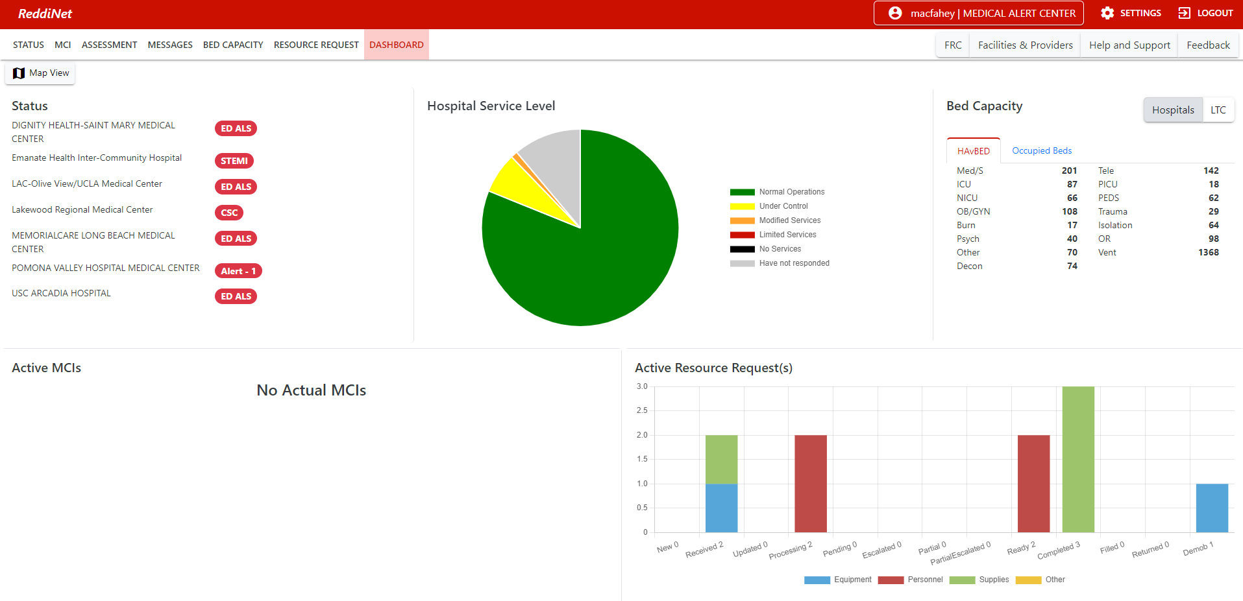
Polling and reporting
ReddiNet
HAvBED
Assessment Polls
Other options
Email
Phone

Slide 5
Resource Requesting Field to MHOAC
Resource requesting platforms
Digital
Paper
Situational Report
Follows SEMS
Field
Local
MHOAC/ County
Region
State

Slide 6
Regional Coordination
Regional
Disaster
Medical
Health
Coordinator
(RDMHC)
Overview
Health and Safety Code §1797.152
ESF – 8 Disaster Coordination
Public Health Officer or LEMSA Director
Volunteer, nonpaid position
Elected by the Health Officers
Appointed by EMSA and CDPH
Have normal day-to-day responsibilities

Slide 7
Regional Coordination
Regional
Disaster
Medical
Health
Specialist
(RDMHS)
Overview
Health and Safety Code §1797.152
ESF – 8 Disaster Coordination
24/7 POC
Standardized reporting
Coordinate mutual aid/assistance within the region
Support activated Med/Health Branch at Regional EOCs
Coordinate with CDPH & EMSA when state level support is needed
Funded position

Slide 8
Polling and reporting
Email
Request poll
Collect results
Share with requesting MHOAC or State
Phone

Slide 9
Resource Requesting MHOAC to RDMHS
Resource requesting platforms
Salesforce - online PHOS
Paper
Phone – call or text
Situational Report (Sit/Rep)
Follows SEMS
Reach out to other MHOACs within the region
Coordinate mutual aid/ resource tracking
Escalate request to the state if unable to fill requests within the region

Slide 10
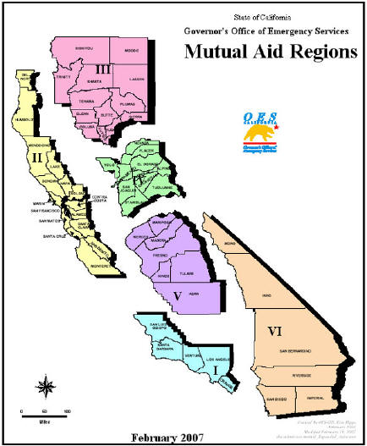
Southern Region Demographics
Comprised of:
Region I: Los Angeles (Includes: Pasadena Public Health and Long Beach Human Health Services), Orange, San Luis Obispo, Santa Barbara, Ventura (5)
Region VI: Imperial, Inyo, Mono, Riverside, San Bernardino, San Diego (6)
Number of LEMSAs served: 11
Number of Public Health Departments: 13
Population: Roughly 19.75 million
Pediatrics served (0 – 14): 5,179,625
Region I: 3,466,155
Region VI: 1,716,470
Total Peds served in CA: 7,646,309
Number of Hospitals – 171

Slide 11
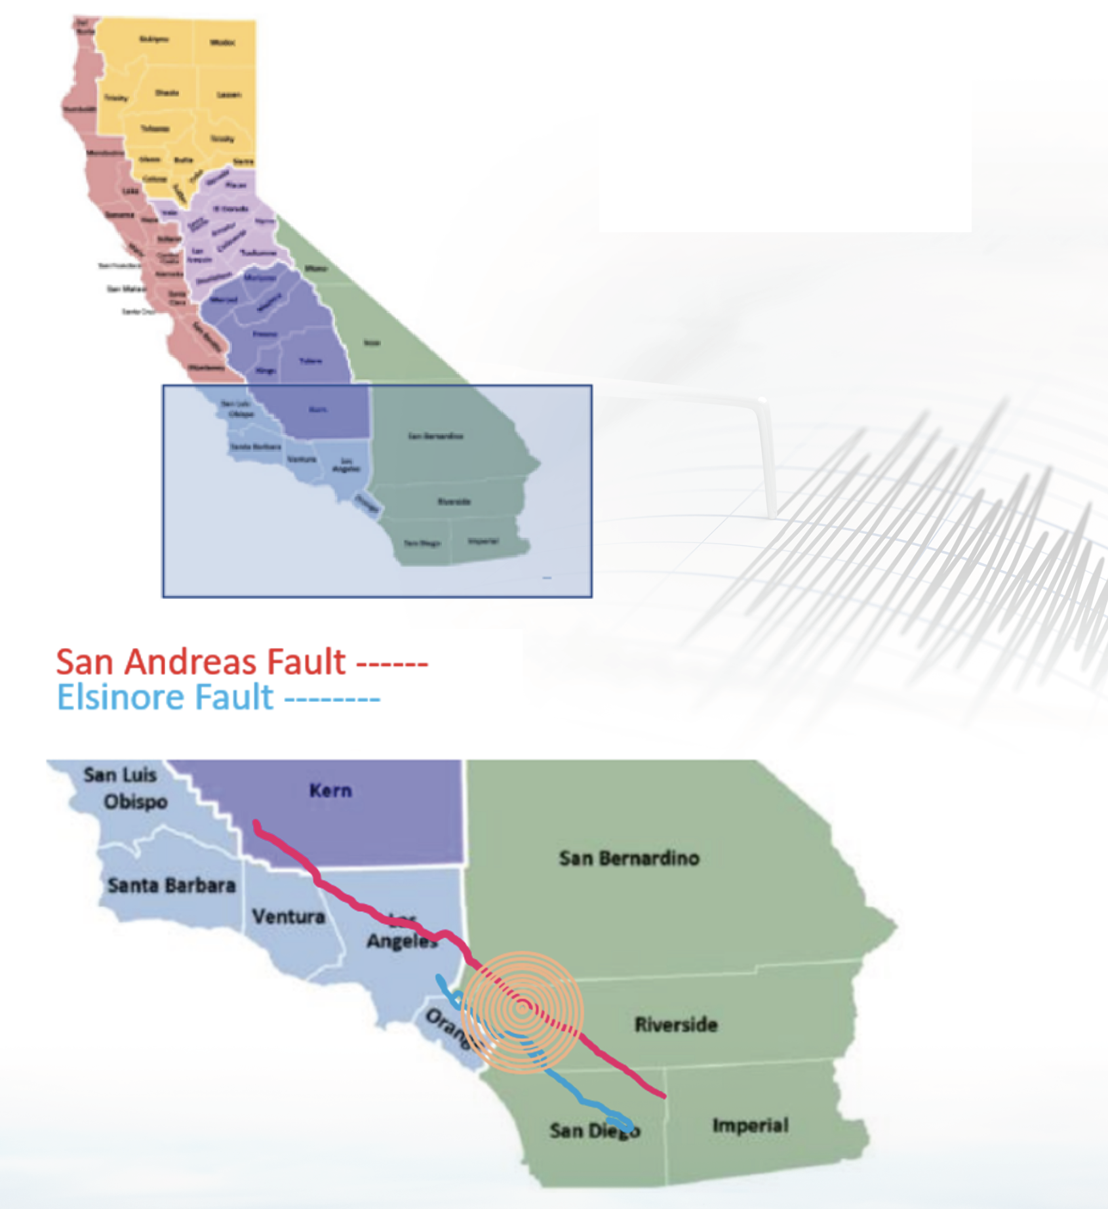
Scenario PROJECTIONS
USGS projects:
47,500 children would be displaced
10,070 children would be injured
Pediatrics with Special Needs
40% - immediately
40% - within 72 hours
20% - within 7 days
Los Angeles County projected to need:
959 pediatric Med/Surg beds
419 PICU Beds

Slide 12
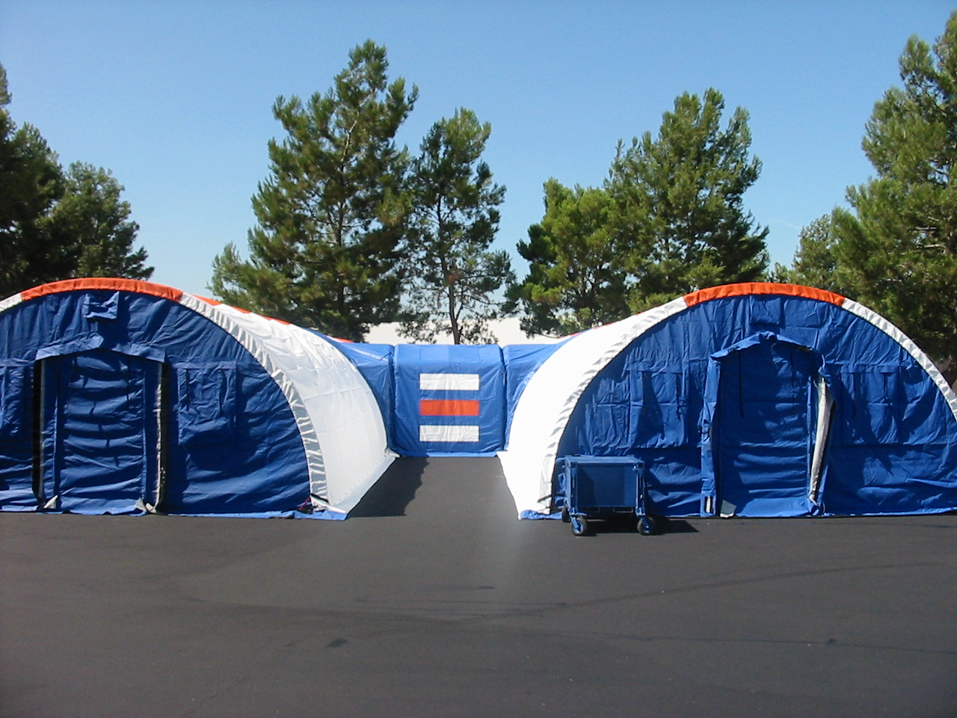
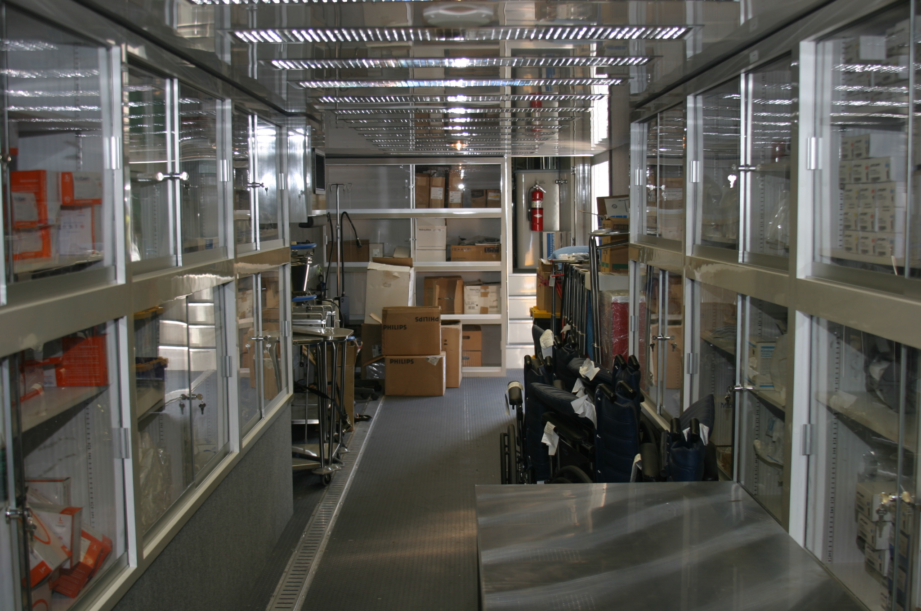
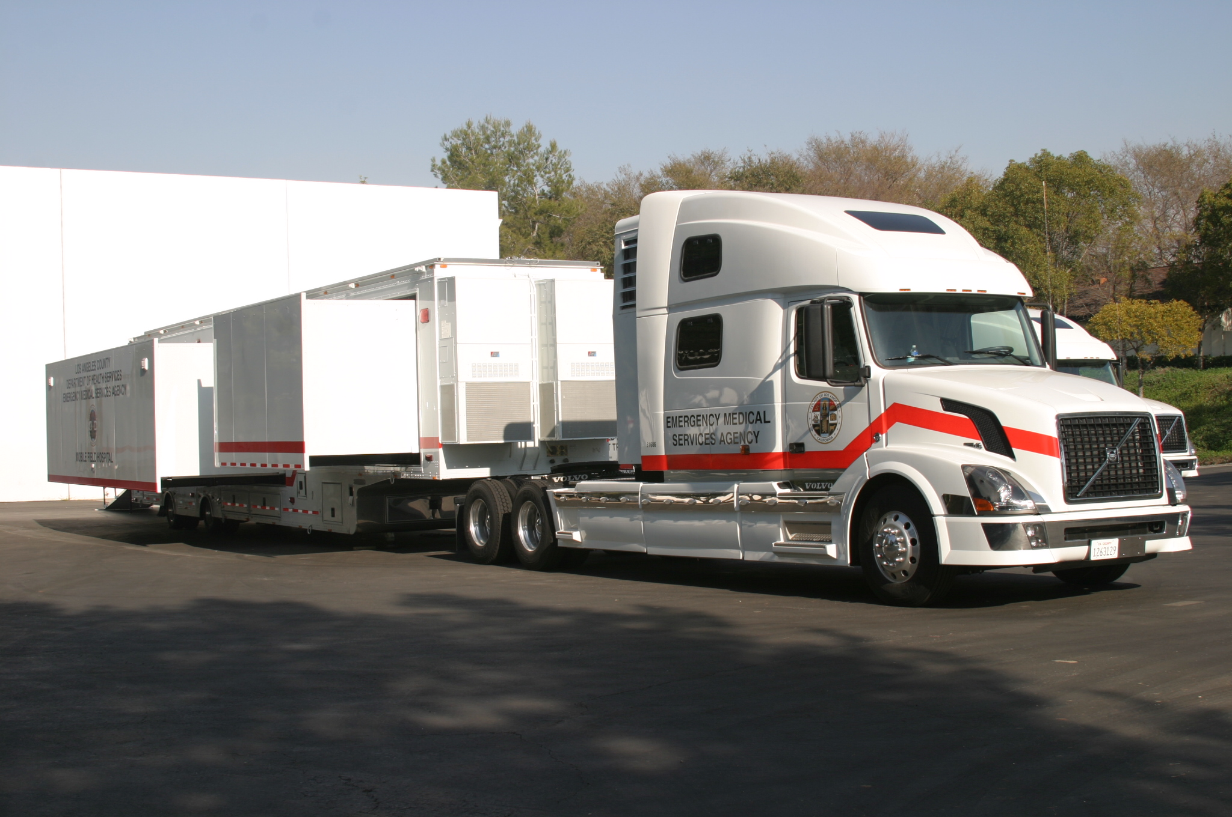
Available resources
Disaster Healthcare Volunteers
Tents – varying models/sizes
1 Mobile Hospital
8 Surge buildout trailers

Slide 13
Projected resource needs
Four S’s
Supplies – pediatric supplies
Staff – pediatric, neonatal certifications
Space – surge buildouts, alternate care sites fit to hold pediatrics (PICU, Peds Med/Surg)
System – ASTs, Air transport

Slide 14
The good
System Strengths
Hospital/MHOAC/RDMHC(S) relationships
Region I and VI Inter-Region Cooperative Agreements
SEMS mutual aid process well established
Paper Sit/Reps and resource requesting forms
Resource Rich

Slide 15
Areas of concern
System Weaknesses
Resource rich
Transfers out of hospitals are held to IFT standards
Issues with higher level of care
Facilities operate at high inpatient census levels
Ingress & Egress
Different MHOAC resource requesting platforms
Lack of Pediatric resources
All levels of disaster response
Specially trained staffing
MHOAC non-funded roll
Usually wear multiple hats

Slide 16
Thank you!

