Slide 1
Patient Tracking: The Critical Data needed for Reunification
Kevin McCulley
Pediatric Pandemic Network
David McCarthy
Western Regional Alliance for Pediatric Emergency Management

Slide 2
Overview
Utah’s search for a patient tracking system
Meeting grant and compliance requirements
Selection and implementation
Defining the Ideal Patient Tracking System

Slide 3
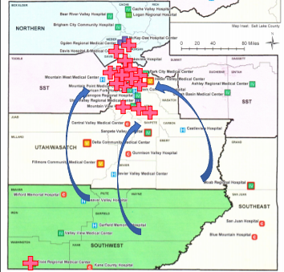
Utah’s Search for Patient Tracking System
Utah - 7 HCCs, 53 hospitals composed of 4 major systems (Intermountain, HCA, Steward, U of U) and 9 rural unaffiliated hospitals
Majority of high-level care (T1/T2, tertiary) is in the SL County/Wasatch Front area (hub/spoke model)
Primary threats that could cause a patient tracking system activation - earthquake, MCI event, wildfires
Utah has a long history of planning with the VA (as a Federal Coordination Center site) and exercising patient receiving during NDMS exercises, using JPATS (Joint Patient Assessment and Tracking System)
Most in-state movement would be toward the hubs, if SL County was to evacuate most of this would go out of state (federal patient movement)

Slide 4
Utah’s Search for Patient Tracking System
Meeting the ASPR HPP requirements
Is this a state or Regional Coalition task?
Agreeing on core elements
Identification/registration
Medical situation review
Matching type to type
Logistics of movement
Repatriation

Slide 5
Utah’s Search for Patient Tracking System
Utah is a small state (3.2M) with a budget for all Healthcare Preparedness Program activity that is ~35th in the Nation
Few events that require extensive patient tracking, as compared to other states (such as annual hurricane threat)
After funding HCCs, hospitals and other partners, there was not enough $$ left in budgets to invest 5 or 6 digits in a commercial patient tracking system that may never be used
After exhaustive analysis, the UT DOH HPP determined that adoption of the Federal Joint Patient Assessment and Tracking System (JPATS) system was the best choice for our use

Slide 6
Utah’s Search for Patient Tracking System
JPATS/UPATS Adoption Review Plus Delta
+Familiarity with the system from prior NDMS exercises
+Local SMEs - the VA Federal Coordination Center staff strong partners
+The cost was $0
+Web based portal
+Encouraged by ASPR
-Free is extremely expensive!!! Server space and protection, limited vendor assistance, little opportunity to personalize
-Required the deployment of super-users to various sites, as access to system and comfort with its use was not intuitive
-Concerns about system access across all points of entry

Slide 7
WRAP-EM: Looking for the ideal Patient Tracking System
Data gathered on what systems exist
Six web or client-based system
Many manual systems
Characteristics and features?
20-30 various
Wish list
Evaluation based on 18

Slide 8
WRAP-EM: Looking for the ideal Patient Tracking System
The Problem:
Patient Tracking is a difficult task
Multiple systems available
Variation in process and system design
Proprietary systems don’t share well
Cost is a roadblock

Slide 9
Delphi Survey of Subject Matter Experts
Next step: Conduct a survey of SME’s
Four questions: What are the most…
Important features or characteristics for Data Collection?
Important features or characteristics for Data Sharing?
Prevalent obstacles for implementation?
Critical data fields that need to be collected?
Goal: Develop a set of standards for PT Systems

Slide 10
Looking for Subject Matter Experts
Experience working with a Patient Tracking and PT Systems
Exposure to multiple PT System
Frontend users/Background users
Multi-discipline
Email: David@epsolutionsaz.com

Slide 11
Patient Tracking: The Critical Data needed for Reunification
Kevin McCulley
kmcculley.ppn@gmail.com
David McCarthy
David@epsolutionsaz.com

