Slide 1
The Hospital Reception Site Template: Addressing the Challenges of Hospital Reception During Disaster
Anna Lin, MD
National Pediatric Disaster Conference Program
Friday, October 28, 2022

Slide 2
Disclosures
The Western Regional Alliance for Pediatric Emergency Management was supported by Award Number 6 U3REP190616-01-02 from the Office of the Assistant Secretary for Preparedness and Response (ASPR).
Dr. Anna Lin receives funding through a subaward for the Pediatric Pandemic Network which is supported by Award U1IMC43532 from the Health Resources and Services Administration (HRSA) through the University of California – San Francisco. She also serves on the Board of Directors for the Society for Pediatric Sedation.

Slide 3
WRAP-EM Hospital Reception Site Planning Group
Emily Carey | Irene Navis
Milissa Chanice | Annette Newman
James G Hodge, Jr | Evette Perez
Anna Lin | Mary Jo Quintero
David McCarthy | Hanna Reinke
Roxanne McCarthy | Deborah Roepke

Slide 4
Objectives
Identify components of family assistance as it pertains to disaster
Differentiate between family assistance center, family reunification center, and hospital reception site
Delineate the organizational infrastructure required for a hospital reception site
Plan for the establishment of a hospital reception site using the WRAP-EM Hospital Reception Site template

Slide 5
Family Assistance
Allows family/friends to gather/receive information about victims
Provides death notifications as victims are identified
Facilitates information sharing to support family reunification
Reunifies separated family members, including unaccompanied minors
Protects families from media inquiries and curiosity-seekers
Refers families to long-term services

Slide 6
FAC, FRC, HRS – What?
Family Assistance Center
Family Reunification Center
Hospital Reception Site
Designated governmental space, longer-term
Designated community space, shorter term
Designated hospital space
Notes:
A space designated by a hospital to provide a private, secure gathering place for family/friends
Similar to a Family Assistance Center

Slide 8
Planning Assumptions
Family members will call or self-report to the hospitals
Expect 8-10 family members/loved ones for each victim
Family members will have high expectations regarding
Accurate and timely information and updates
Identification of the deceased
Return of loved ones and their belongings
Hospitals may not be able to meet these expectations due to forensic issues or resource shortages
Coordination among responding agencies about family members, missing persons, and patient tracking will be necessary

Slide 9
Additional Points
Ambiguity
Communication
Mental health/Spiritual care resources
Support for healthcare workers
Consideration regarding patient privacy

Slide 10
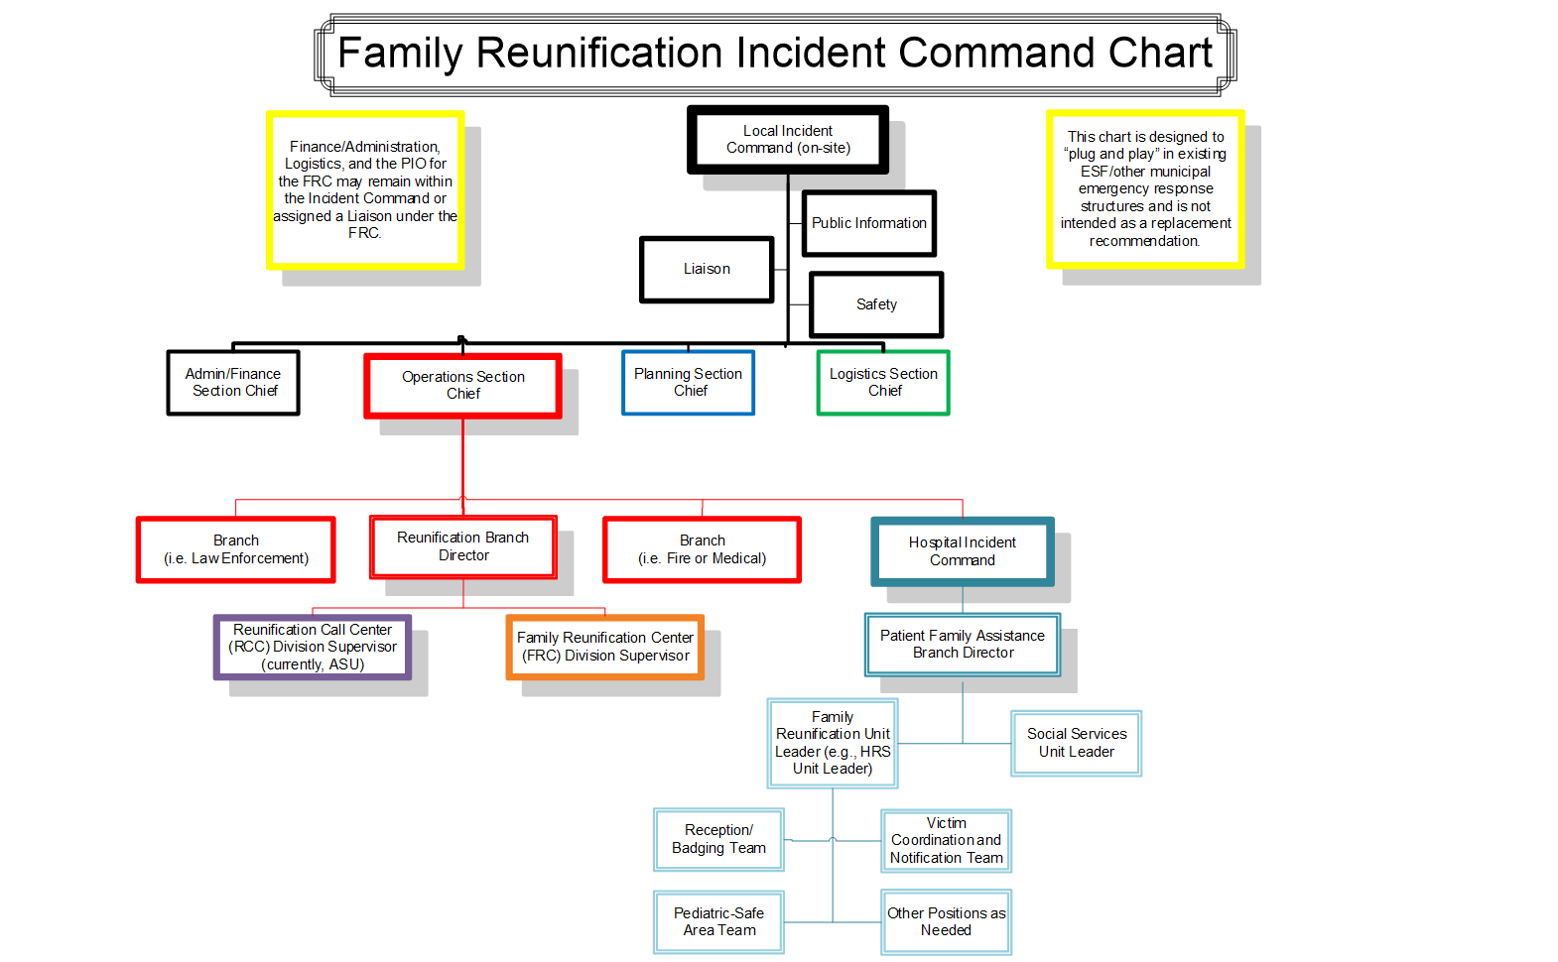

Slide 12
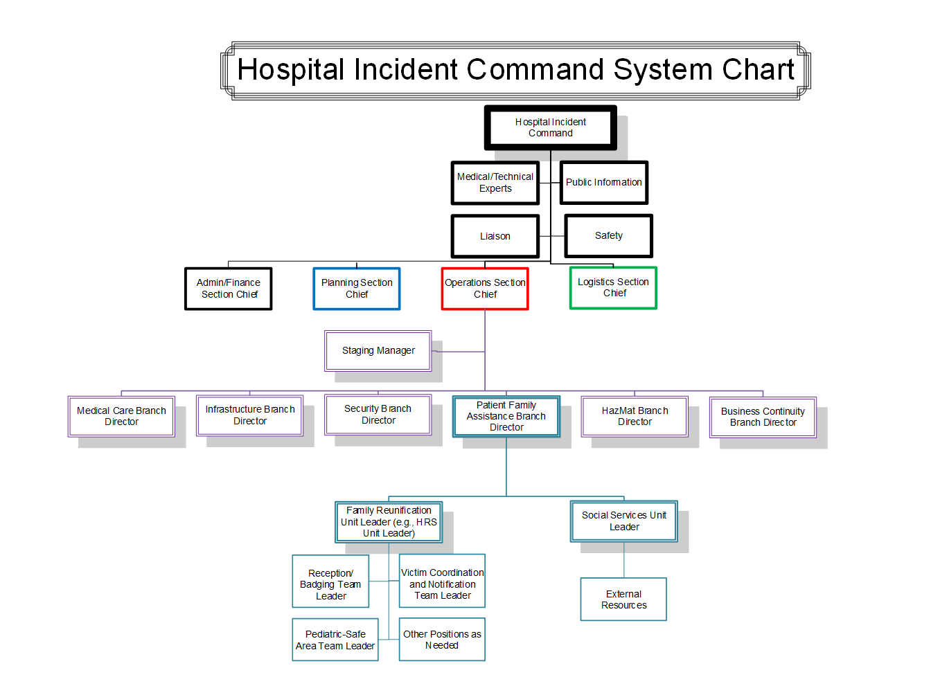

Slide 14
Considerations for Site Selection
Site accessibility (ease of access from major roads/freeways/public transit, proximity to medical center, availability on short notice, parking, controlled ingress/egress, easily secured area)
Usable space and resource (restrooms, tap water source, telephones, security stations, reception area, badging area, family interview/notification/counseling areas, childcare areas – including pediatric safe area which is separate from where family gathers, staff work/break areas, briefing areas)
Communications (telecommunication infrastructure, tables/chairs, translation services, computer access, access to social media, radios, televisions/TV monitors)

Slide 15
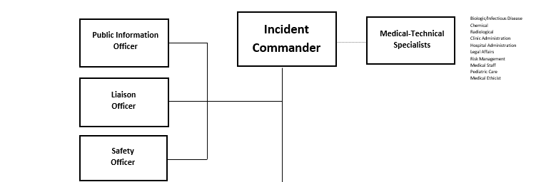
HICS Command Staff
Activates HRS
Manages communications to public re: victim inquiries
Communicates with external agencies re: HRS activation

Slide 16
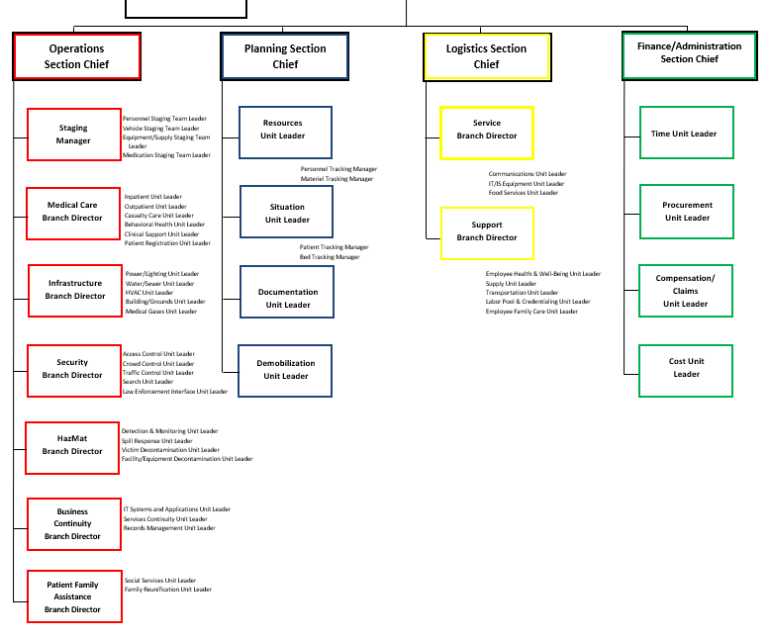
Assigns PFABD
General Staff
Set up call center for inquiries
Designate space(s) for HRS
Ingress & egress to HRS

Slide 17
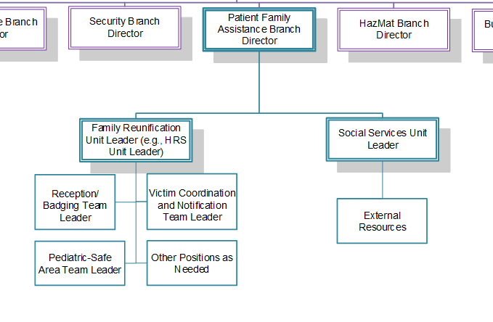
Organize and manage delivery of assistance to families

Slide 18
Organize and manage the services and processes required to assist in family reunification

Slide 19
Oversee Reception and Check-in Unit, assures access and functional needs are addressed

Slide 20
Example Forms

Slide 21
Monitors data collection, ensures evidence-based behavioral health practices are applied to communications with family/friends, provides crisis assessments and referrals

Slide 22
Monitors data collection, ensures evidence-based behavioral health practices are applied to communications with family/friends, provides crisis assessments and referrals
Notes:
IT IS STRONGLY RECOMMENDED THIS POSITION BE FILLED BY SOMEONE WITH EXPERIENCE IN DEATH NOTIFICATION AND CRISIS COUNSELING.

Slide 23
Responsible for the care of uninjured, unaccompanied minors or minors placed in their care
Notes:
IT IS STRONGLY RECOMMENDED THIS POSITION BE FILLED BY SOMEONE FAMILIAR WITH PEDIATRICS.

Slide 24
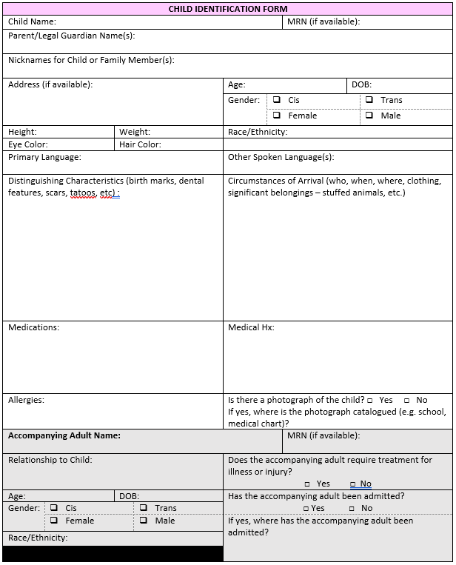
Child Identification Form Example

Slide 25
Family Intake Workflow

Slide 26
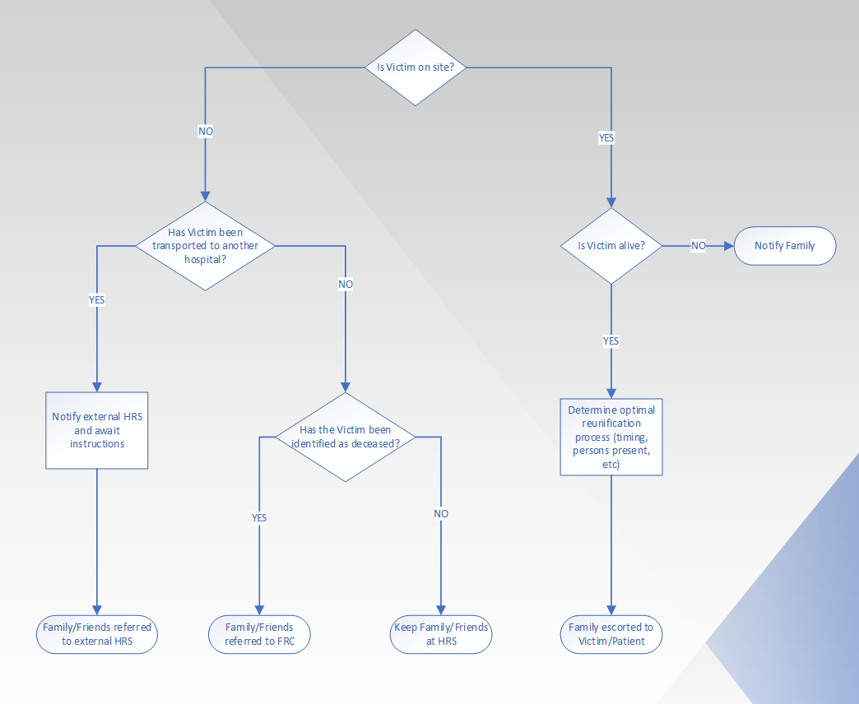
Family Notification Process

Slide 27
Psychological First Aid for Disaster Survivors
Recreate sense of safety
1
Encourage social support
2
Re-establish sense of efficacy
3
Notes:
Re-create sense of safety:
Provide for basic needs (food, clothing, and medical care).
Ensure that survivors are safe and protected from reminders of the event.
Protect them from on-lookers and the media.
Help them establish a “personal space” and preserve privacy and modesty.

Slide 28
Psychological First Aid for Disaster Survivors
Provide for basic needs (food, clothing, and medical care).
Ensure that survivors are safe and protected from reminders of the event.
Protect them from on-lookers and the media.
Help them establish a “personal space” and preserve privacy and modesty.
Recreate sense of safety
1
Encourage social support
2
Re-establish sense of efficacy
3
Notes:
Re-create sense of safety:
Provide for basic needs (food, clothing, and medical care).
Ensure that survivors are safe and protected from reminders of the event.
Protect them from on-lookers and the media.
Help them establish a “personal space” and preserve privacy and modesty.

Slide 29
Psychological First Aid for Disaster Survivors
Help survivors connect with family and friends (most urgently, children with parents).
Educate family and friends about survivors’ normal reactions and how they can help.
Recreate sense of safety
1
Encourage social support
2
Re-establish sense of efficacy
3
Notes:
Re-create sense of safety:
Provide for basic needs (food, clothing, and medical care).
Ensure that survivors are safe and protected from reminders of the event.
Protect them from on-lookers and the media.
Help them establish a “personal space” and preserve privacy and modesty.

Slide 30
Normal Reactions
Emotional
Shock, fear, grief, anger, guilt, shame helplessness, hopelessness, numbness, emptiness.
Cognitive
Confusion, disorientation, indecisiveness, worry, shortened attention span, poor concentration, memory difficulties, unwanted memories, self-blame.
Physical
Confusion, disorientation, indecisiveness, worry, shortened attention span, poor concentration, memory difficulties, unwanted memories, self-blame.
Decreased ability to feel interest, pleasure, love.
Interpersonal
Difficulties being intimate, being over-controlling, feeling rejected or abandoned.

Slide 31
Age-specific Disaster Responses
Pre-school
Separation fears, regression, fussiness, temper tantrums
Sleep disturbances (nightmares, excessive sleep, night terrors)
School-Age
Same as toddlers
Excessive guilt and worries about others’ safety, poor concentration, loss of school performance, repetitious re-telling or play related to trauma
Adolescent
Depression, acting out, wish for revenge, sleeping and eating disturbances, altered view of the future

Slide 32
Psychological First Aid for Disaster Survivors
Give survivors accurate simple information about plans and events.
Allow survivors to discuss events and feelings, but do not probe.
Encourage them to re-establish normal routines and roles when possible.
Help resolve practical problems, such as getting transportation or relief vouchers.
Encourage survivors to support and assist others.
Recreate sense of safety
1
Encourage social support
2
Re-establish sense of efficacy
3
Notes:
Re-create sense of safety:
Provide for basic needs (food, clothing, and medical care).
Ensure that survivors are safe and protected from reminders of the event.
Protect them from on-lookers and the media.
Help them establish a “personal space” and preserve privacy and modesty.

Slide 33
Poll #1
Where are your children – or beloved family memberS - right now?

Slide 34
Notes:
Poll Title: Do not modify the notes in this section to avoid tampering with the Poll Everywhere activity. More info at polleverywhere.com/support Where are your children - or beloved family members - right now? https://www.polleverywhere.com/free_text_polls/HLdmTB4oBW41f22n1BLQz

Slide 35
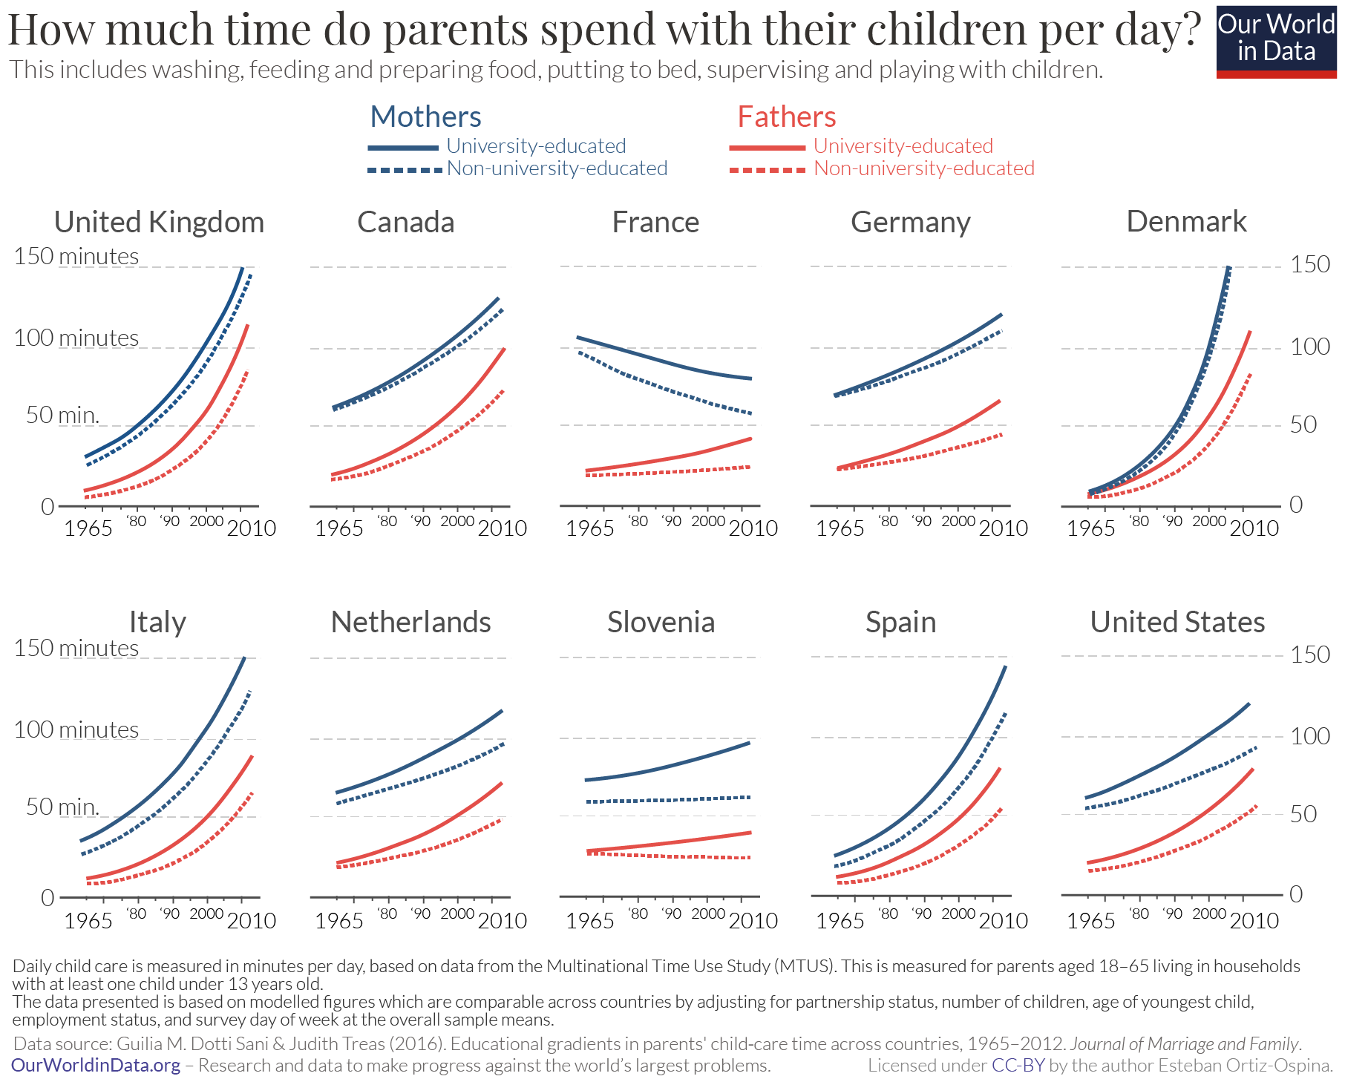
Reunification of Children After Disaster
From: https://ourworldindata.org/parents-time-with-kids

Slide 36
A Day in the Life of School-Aged Child
~ 40% of time is spent away from parent

Slide 37
Impacts of Parent-Child Separation
Mental health problems
Social-cognitive development
Physical health issues
Anxiety, depression, PTSD
Attachment, self-esteem, lower IQ
Poor growth, obesity, immune dysfunction, cancer, heart and lung disease, stroke
Notes:
Bouza J, Camacho-Thompson DE, Carlo G et al. The Science is Clear: Separating Families has Long-term Damaging Psychological and Health Consequences for Children, Families, and Communities. Society for Research in Child Development Statement of the Evidence, 2018
Parent-child separation considered a toxic stressor (changes the body’s stress-management system) – parents often mitigate the effects of disaster trauma on children and so separation amplifies these effects

Slide 38
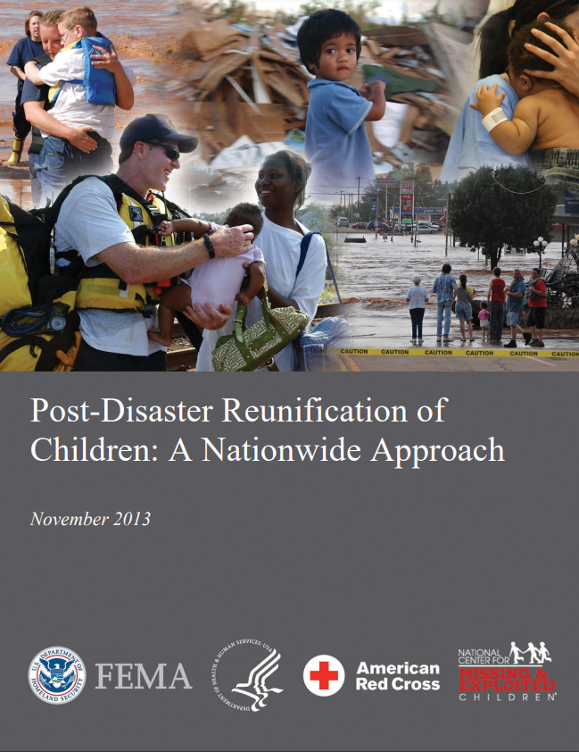
Reunification of Children and Families after Disaster
Predetermine the process for reunification for unaccompanied, uninjured minors
Challenges
Children may not be able to self-identify
Parents/legal guardians may not be able to assume care
Capabilities to verify legal custody may be hampered
Hospitals will need to plan for maintaining the care of unaccompanied, uninjured minors until they can be released to state custody/foster care or reunified with their families

Slide 39
Minor Separated from Parent/Legal Guardian

Slide 40
Parent/Legal Guardian Seeking Missing Child

Slide 41
Deceased Unaccompanied Minor

